Slide 1

Drops Of Wisdom: Logical Fallacies –how Logic are they?
Logical Thinking Course
University of Central Punjab

Slide 2
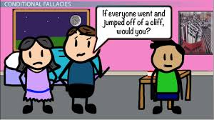
Learning Objectives
know what are logical fallacies
Identify the top 10 logical fallacies
Isolate the use of the effective Appeal
Share and Relate

Slide 3
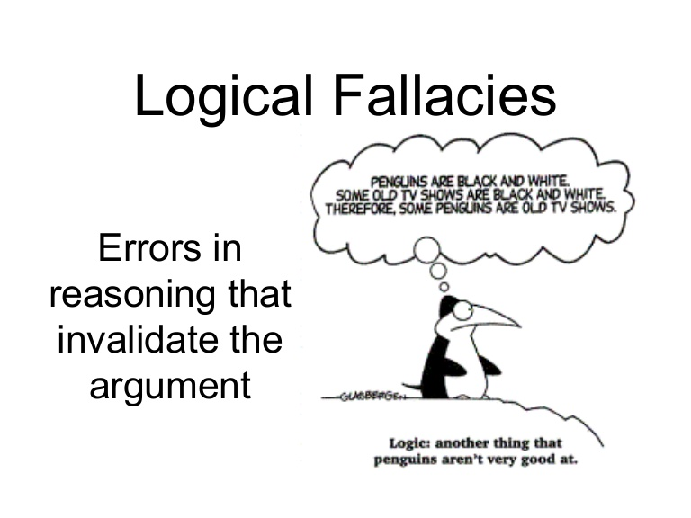
A logical fallacy is an error in reasoning that renders an argument invalid.
All Logical Fallacies are arguments in which a conclusion does not follow logically from what preceded it.
Logical fallacies are unsubstantiated assertions that are often delivered with a conviction that makes them sound as though they are proven facts

Slide 4
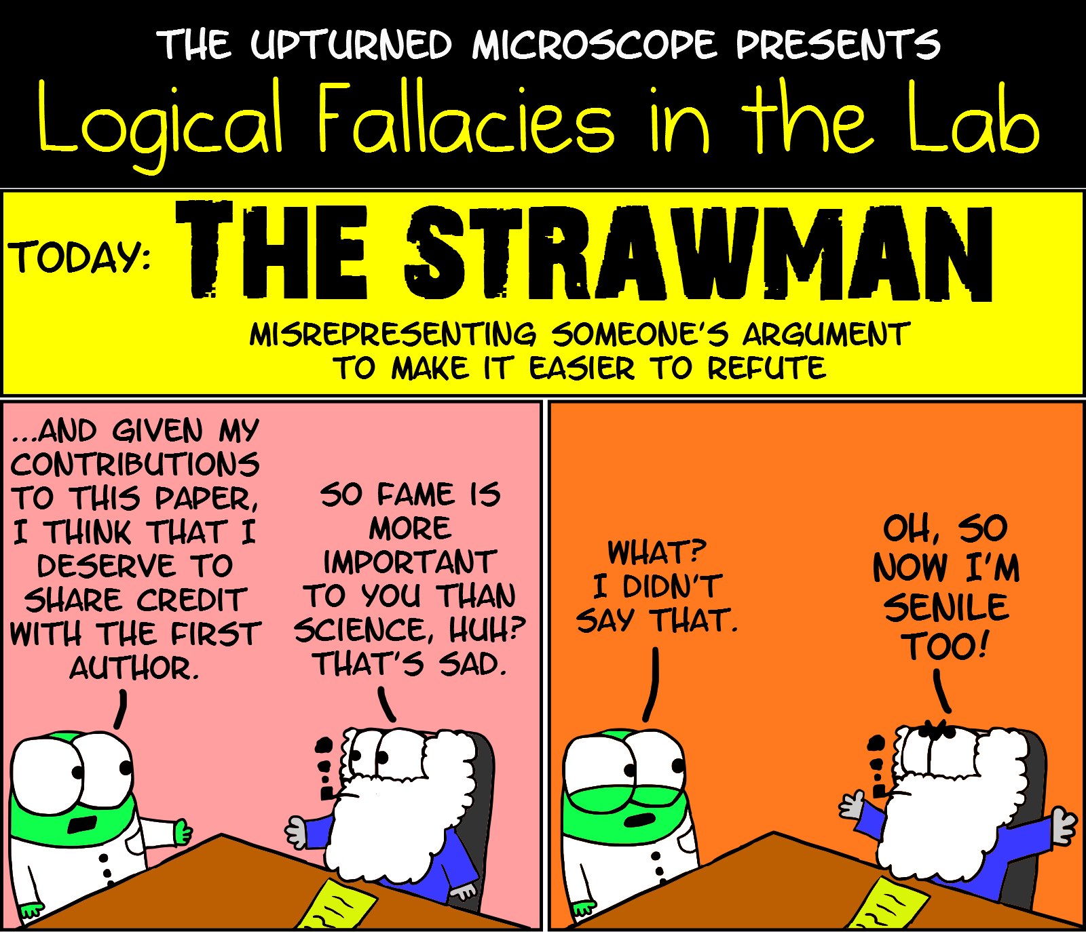
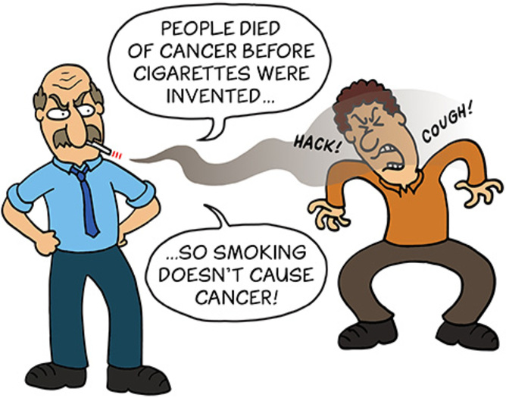

Slide 5
Example of Strawman Fallacy
A type of fallacy which is used as a way of attacking the argument of the opposition.
Example: Pakistan Peoples Party says that the nation should not add to the defense budget. Senator says that he cannot believe that PPP wants to leave the nation defenseless.
Example: Student tells his professor that he thinks some of Donald Trump's positions have merit. Professor says he can't believe that the student supports racism.

Slide 6
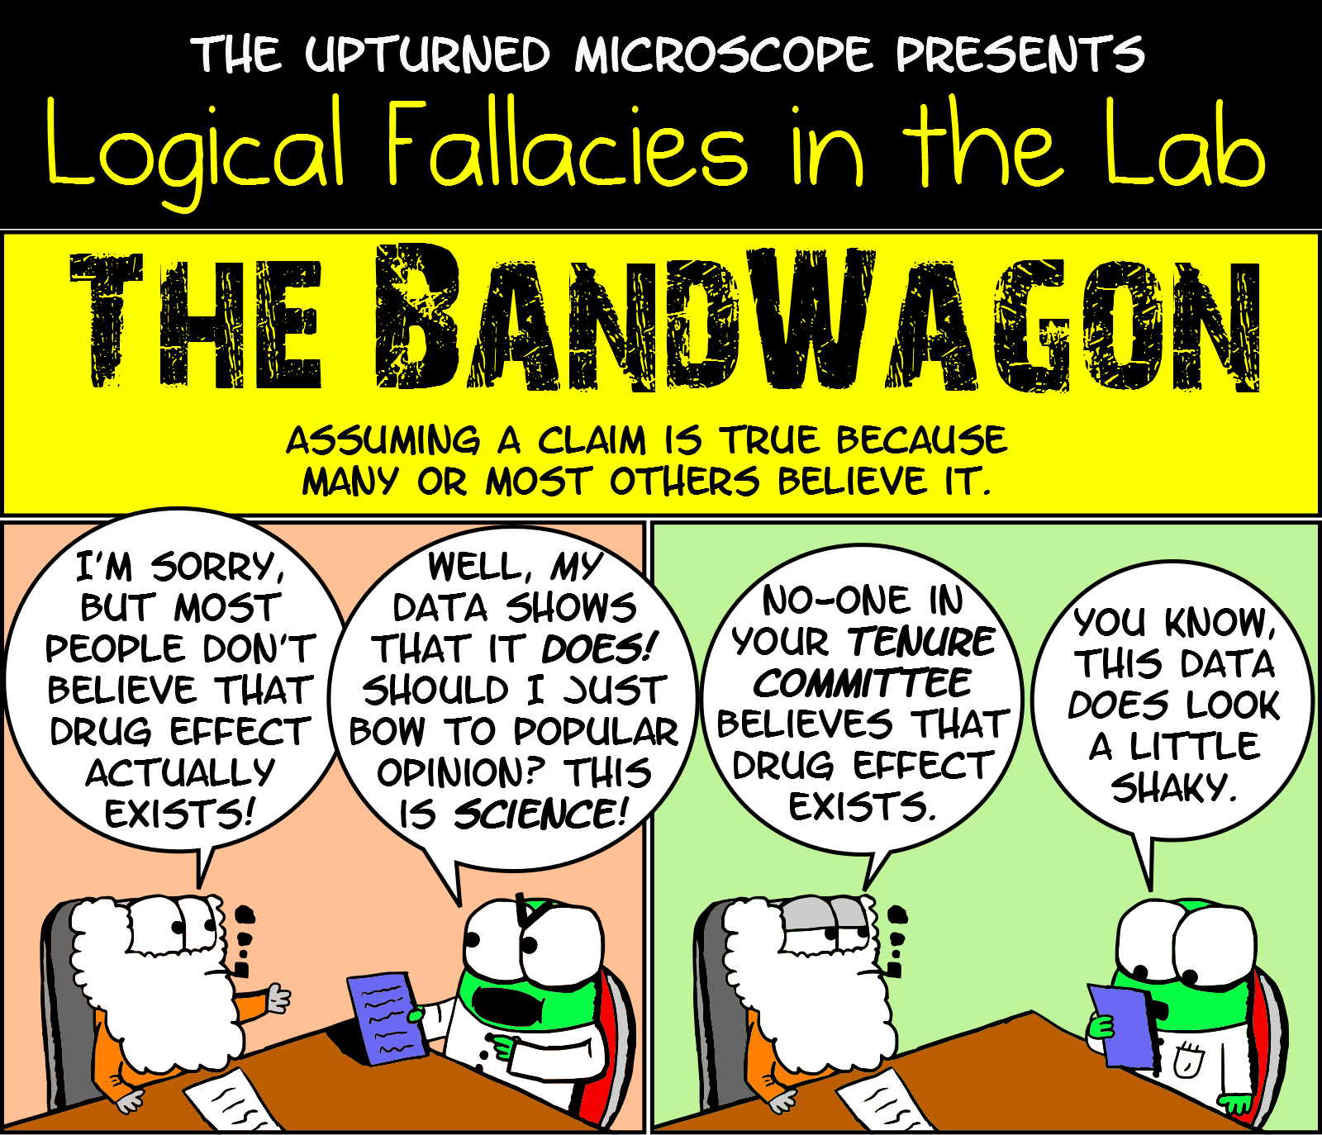

Slide 7
Example of bandwagon Fallacy
The bandwagon fallacy is also sometimes called the appeal to common belief or appeal to the masses because it's all about getting people to do or think something because “everyone else is doing it” or “everything else thinks this.”
Example: Tooba likes to read and would rather do that than play sports. Her friends make fun of her and tell her that reading is for nerds. Tooba stops reading so much and starts to play sports more.

Slide 8
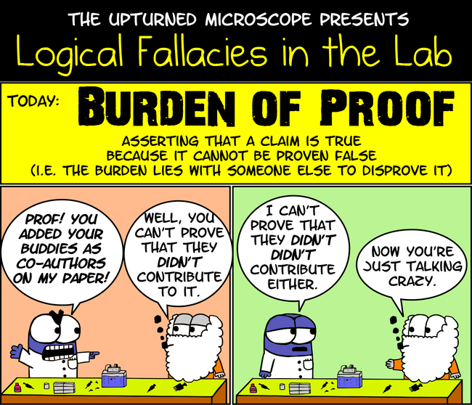

Slide 9
Example of burden of proof Fallacy
If a person claims that X is true, it is their responsibility to provide evidence in support of that assertion. It is invalid to claim that X is true until someone else can prove that X is not true. Similarly, it is also invalid to claim that X is true because it's impossible to prove that X is false. In other words, just because there is no evidence presented against something, that doesn't automatically make that thing true.
Example: Affan believes the marketing agency's office is haunted, since no one has ever proven that it isn't haunted.

Slide 10
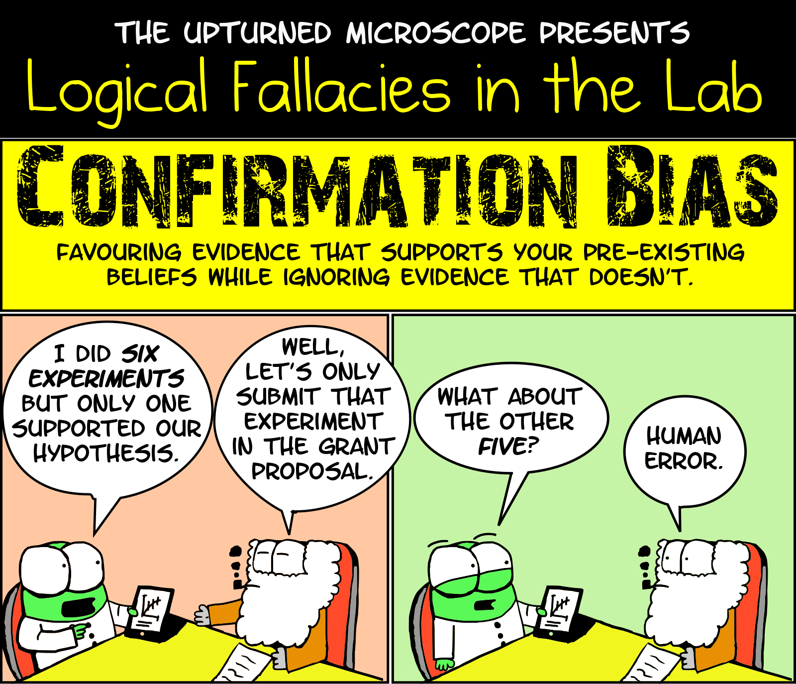

Slide 11
Example of Confirmation Bias Fallacy
Confirmation bias occurs when a person interprets a situation according to their own pre-existing beliefs.
People who support or oppose a particular issue will not only seek information to support it, they will also interpret news stories in a way that upholds their existing ideas.
For example, imagine that a person holds a belief that left-handed people are more creative than right-handed people. Whenever this person encounters a person that is both left-handed and creative, they place greater importance on this "evidence" that supports what they already believe.

Slide 12
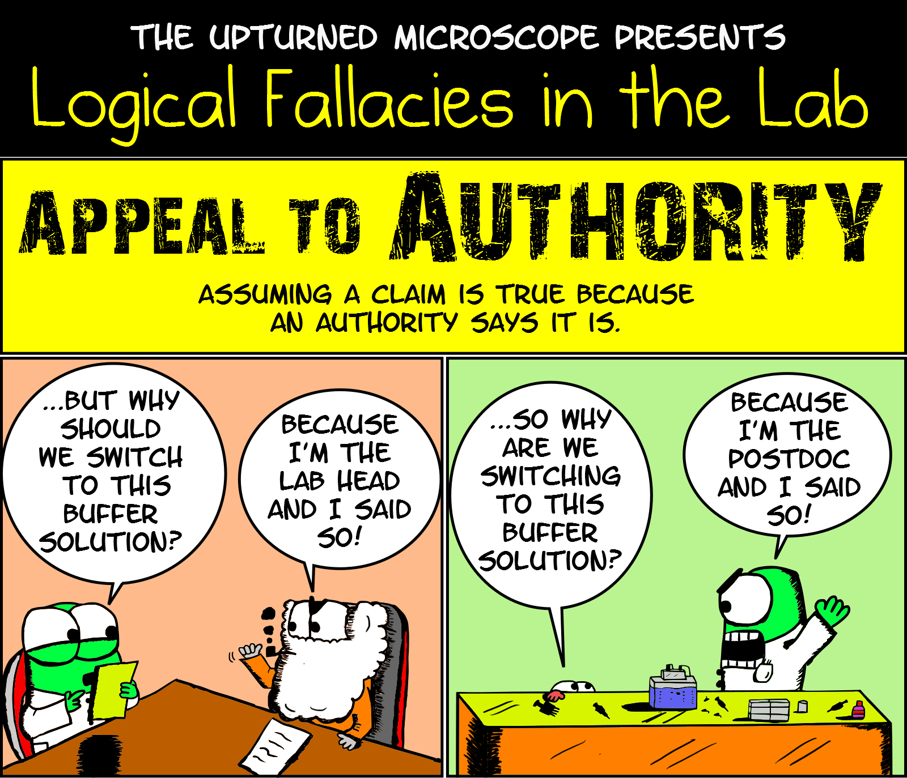

Slide 13
Example of APPEAL TO AUTHORITY Fallacy
Insisting that a claim is true simply because a valid authority or expert on the issue said it was true, without any other supporting evidence offered.
Example:
A commercial claims that a specific brand of cereal is the best way to start the day because athlete Waseem Akram says that it is what he eats every day for breakfast.
A book argues that global warming is not actually happening, and cites the research of one environmental scientist who has been studying climate change for several years.

Slide 14
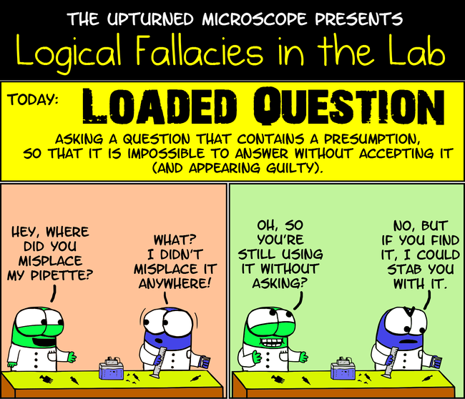

Slide 15
Example of loaded question Fallacy
This fallacy occurs when someone asks a question containing an unjustified (and often offensive) presupposition.
Example:
“So you are going to vote for that incompetent candidate?”
“Why are you so lazy?”

Slide 16
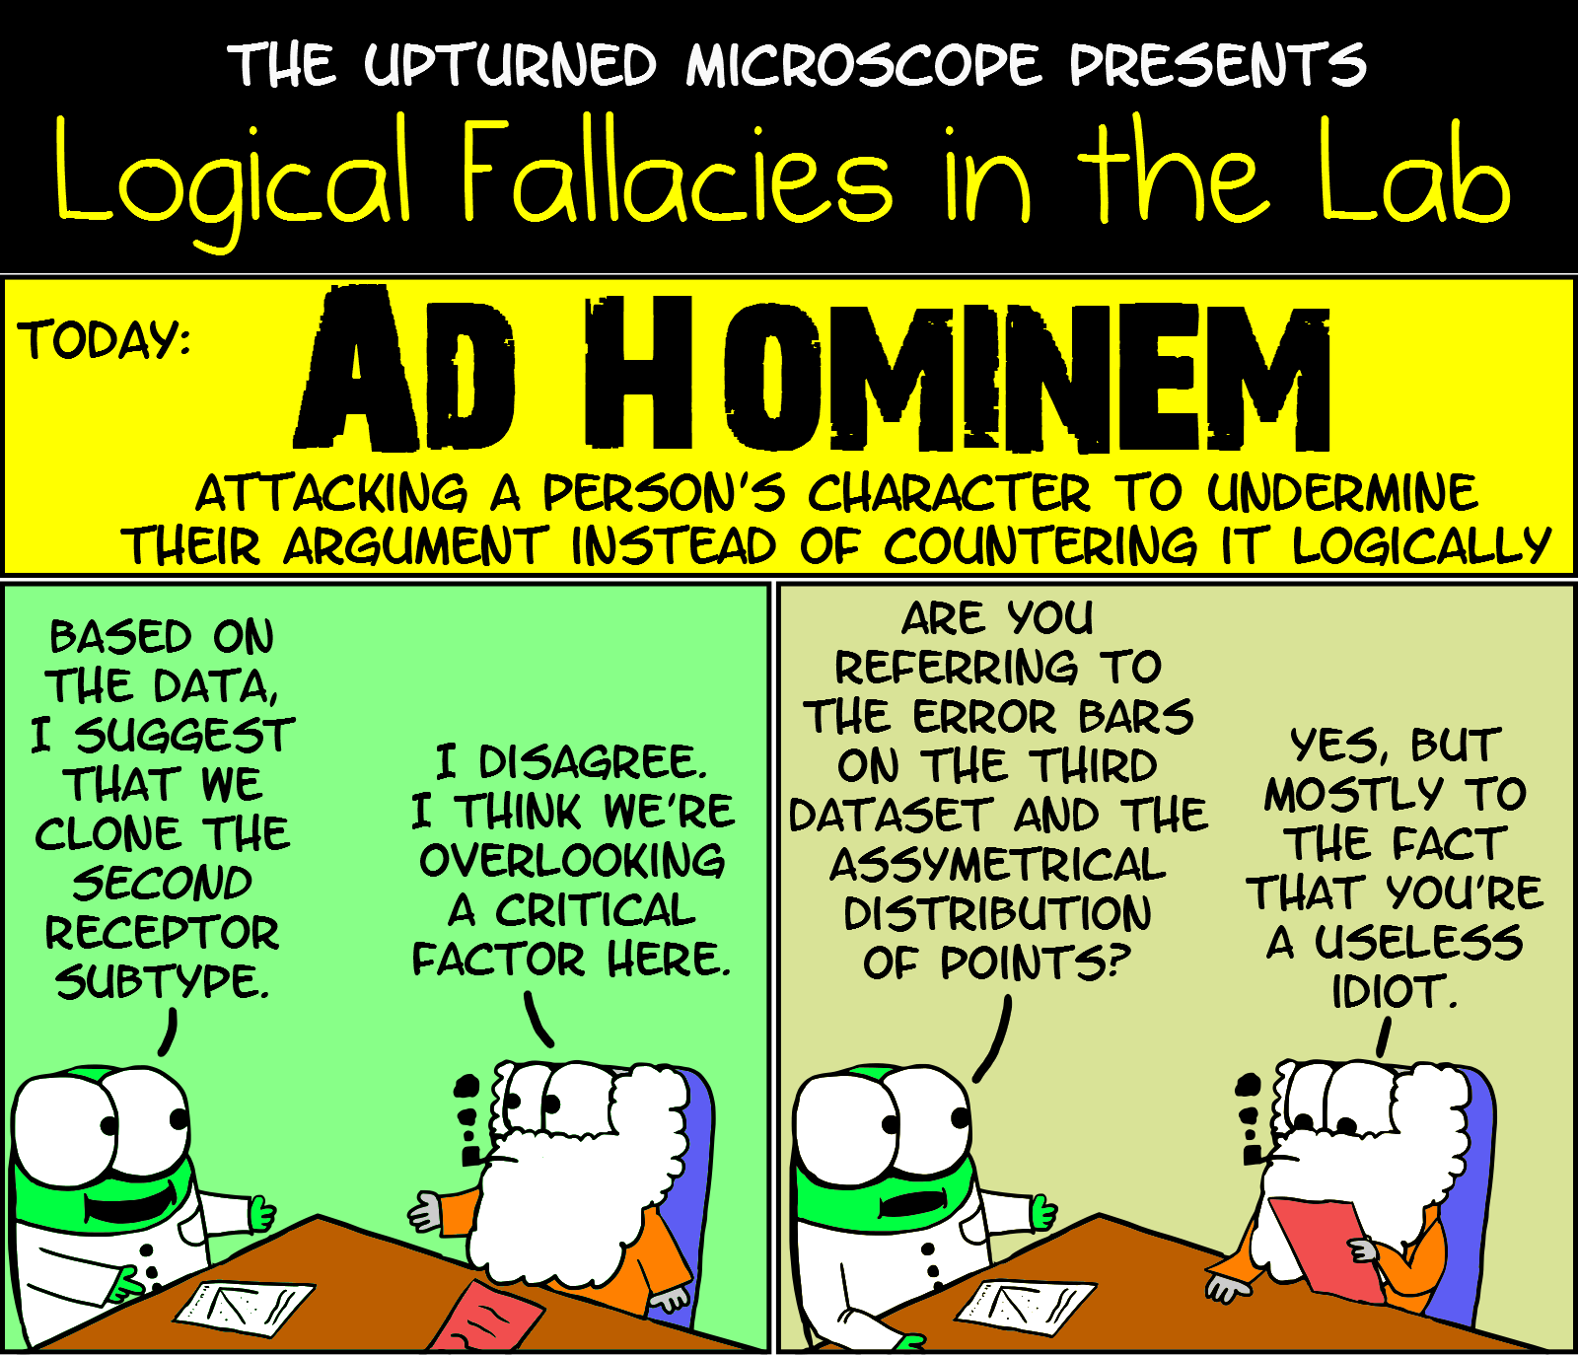

Slide 17
Example of AD HOMINEM Fallacy
You attacked your opponent's character or personal traits in an attempt to undermine their argument.
Example:
A: “All murderers are criminals, but a thief isn’t a murderer, and so can’t be a criminal.” B: “Well, you’re a thief and a criminal, so there goes your argument.”
I was assigned a personal trainer at the Rec, and he gave me a new workout program. But I don't have any confidence in his expertise, since he has obvious trouble controlling his own appetite.

Slide 18
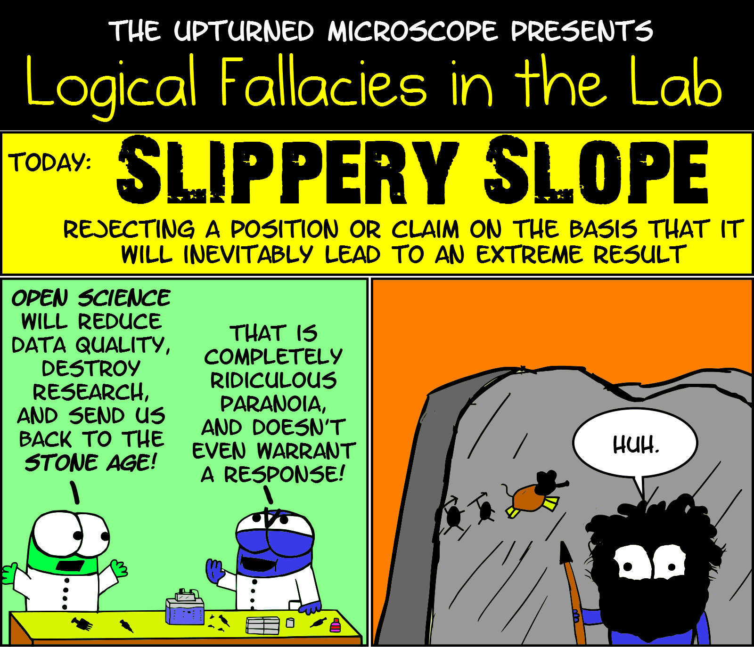

Slide 19
Example of slippery slope Fallacy
A slippery slope argument takes an initial premise and sees it through a chain of consequences until you arrive at an unacceptable, undesirable, or disastrous outcome.
Example:
If you don't do your homework, you'll fail the class.
If you fail this class, you won't graduate from school.
If you don't graduate, you won't get into college.
If you don't attend a good college, you won't get a good job.
If you don't get a good job, you'll be poor and homeless.
You don't want to be poor and homeless, do you?

Slide 20
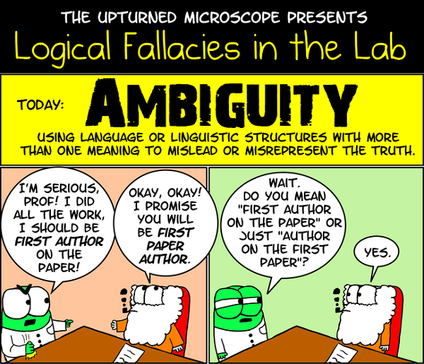

Slide 21
Example of Ambiguity Fallacy
The ambiguity in question arises directly from the poor grammatical structure in a sentence.
The fallacy occurs when a bad argument relies on the grammatical ambiguity to sound strong and logical.
Example: It is said that we have a good understanding of our universe. Therefore, we know exactly how it began and exactly when.
Explanation: The ambiguity here is what exactly “good understanding” means. The conclusion assumes a much better understanding than is suggested in the premise; therefore, we have the ambiguity fallacy.
A feather is light. And light cannot be dark.
So, feather cannot be dark.

Slide 22
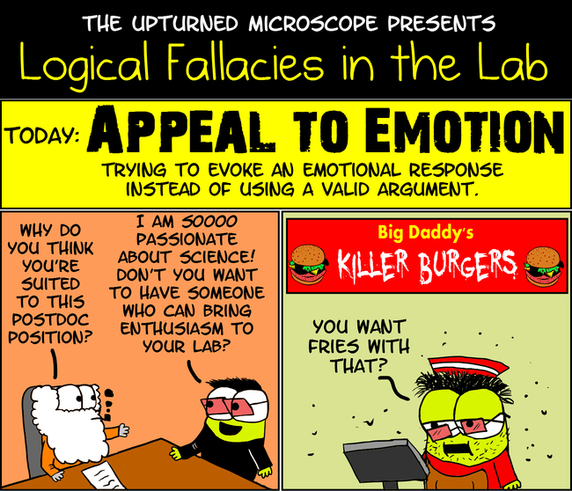

Slide 23
Example of Appeal to emotion Fallacy
An appeal to emotion is a specific type of fallacy in which one manipulates another's emotions to win an argument.
Example:
Grocery store commercial that shows a happy family sitting around the table at Eid while having their products.
A principal who talks with his faculty about doing the right things to support students just before he asks for a volunteer to lead the after-school science club.

Slide 24
Logical Fallacies in Ads / Videos
https://youtu.be/eOVHypzwf0U
https://youtu.be/Zg5stnNn0_U
https://youtu.be/qGVMqHtNdXI
https://youtu.be/maPB_KMmMJU
https://youtu.be/ziZidVO3L8U

